Slide 1
OpenFIDO
Joint CPR #1 (May 2020)
EPC 17-043 EPC 17-046 EPC 17-047
GLOW HiPAS OpenFIDO
This presentation was prepared with funding from the California Energy Commission under grant EPC-17-047. SLAC National Accelerator Laboratory is operated for the US Department of Energy by Stanford University under Contract No. DE-AC02-76SF00515

Slide 2
Project Objectives
Provide framework for three utility data/model management use-cases
Data/model acquisition - collect from various tools and databases
Include support for all HiPAS and NRECA import converters
Data/model curation - clean and collate, plot and report
Include viewers and HiPAS-developed post-processing tools
Data/model delivery - send back to various tools and databases
Include support for all HiPAS and NRECA export converters

Slide 3
Project Status
Data/model acquisition
Existing tools are being transferred from GridLAB-D to OpenFIDO
New tools are being developed by HiPAS for active use-cases
Data/model curation
Workflow manager prototype operational
Plot viewer prototype operational
Data/model delivery
Tools transfer from HiPAS to OpenFIDO pending

Slide 4
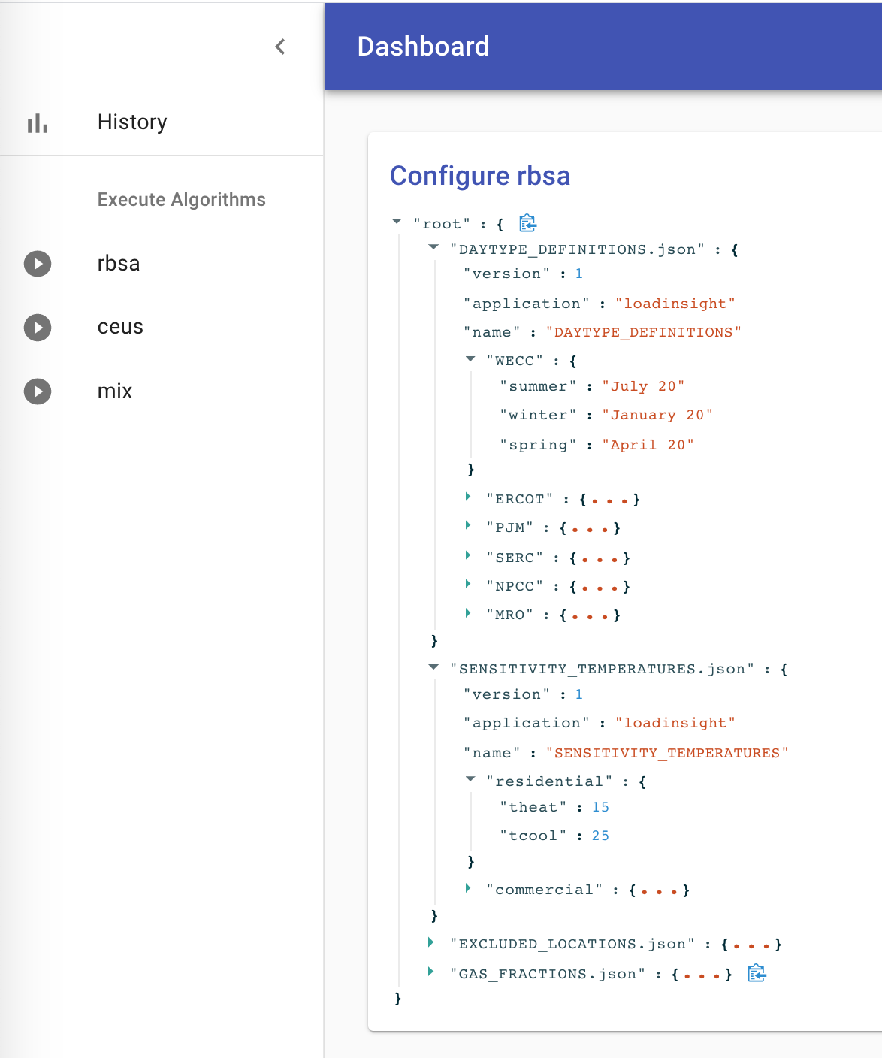
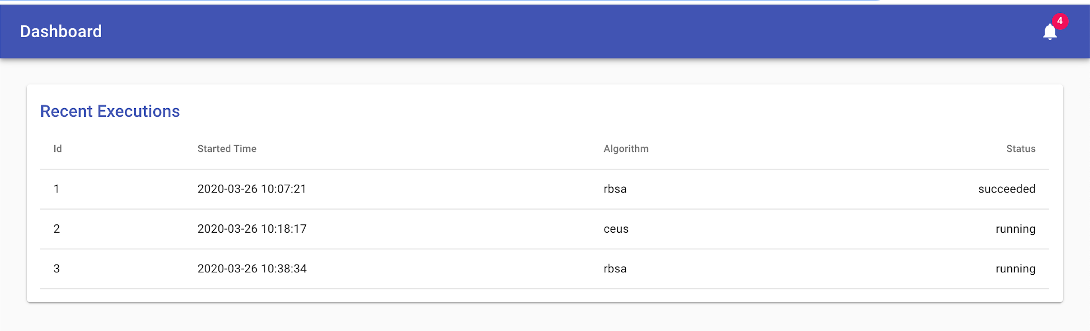
Prototype workflow tool

Slide 5
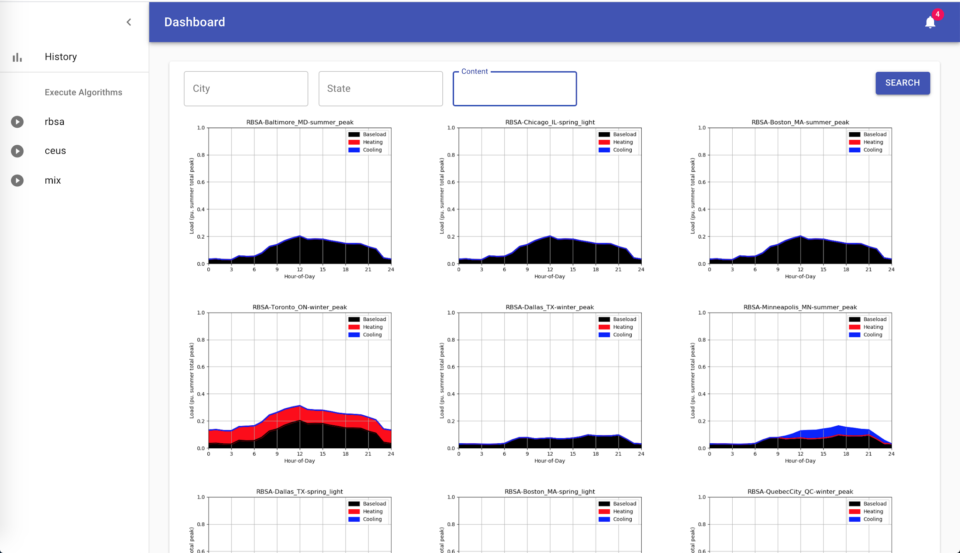
Plot-viewer tool

Slide 6
DOE OTT Commercialization Phase 1: LoadInsight
Platform for utility data/model integration and analysis
Based on NERC LMTF use-case (generate load models from data)
Subcontract for platform deployment
PresencePG subcontractor (developer of GRIP UX)
MVP delivery scheduled for 30 June 2020
White-labelled version basis for OpenFIDO
OpenFIDO requires additional effort by PresencePG (new subcontract)

Slide 7
Addressing the data for validation problem
Coordination with DOE projects
Enabled by GRIP deployment/validation activities (SCE and NRECA)
Based on LoadInsight commercialization task (PresencePG)
Access to full-scale utility data
SCE cloud deployment of HiPAS and OpenFIDO
Access to SCE data within SCE cloud environment
Formal validation scheduled to begin Oct 2020

Slide 8
TAC Feedback
Do TAC members wish to participate in validation?
SCE is hosting GRIP validation exercise and will provide feedback
SCE is working on new use cases for OpenFIDO and HiPAS
Managing workplace charging (EV parking load model)
Storage resilience (like Green Mountain Power)

Slide 9
Status Update: Rebudget Request
Hiring stopped due to COVID-19 response
Key staff attrition in December
Currently all staff working from home
Lab reopen will take several months
Plan to onboard PresencePG as subcontractor
Relabeling of LoadInsight platform
Redeploy HiPAS data import/export converters to OpenFIDO
Deploy OpenFIDO on AWS
Shift of SLAC labor to Subcontract
Requires rebudget ok from CEC (in progress)

Slide 10
Thank You
Contact: dchassin@slac.stanford.edu

Slide 11
Project Focus Area
External
datasets
Import & Validate (OpenFIDO)
Exported data files
External models
Simulate
(HiPAS & GLOW)
Analyse (GLOW & OpenFIDO)
Plots and Reports
Shared datasets
Cloud Ops
(HiPAS)
Database
records
Shared models

